Slide 2
Objectives
Understand the concept of a digital currency and how digital currencies are used
Understand the process of blockchain and how it is used to track digital currency transactions

Slide 3


Starter
We use it all the time, but what is currency?

Slide 4
Starter
Currencies have the following properties:
Medium of exchange and trade (fungible)
It can be reused multiple times (durable)
It can be easily carried around (portable)
Other people should understand its value (recognisable)
The value of the currency should be fairly constant over time (stable)
Currencies are usually created by a country’s government
It is accepted as payment for taxes and debts

Slide 5
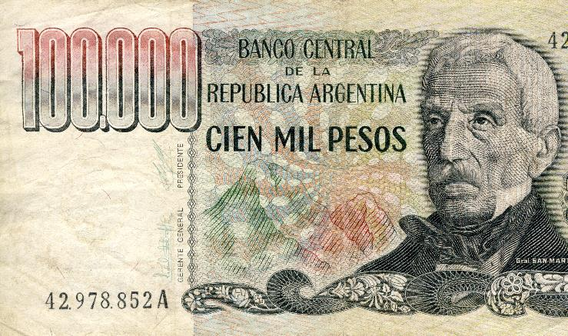
Problems with currency
Currencies may be thought of as the notes and coins we use to buy goods
Currency also includes the numbers in a bank’s computer that register our account balance
What are some problems with currencies?

Slide 6
Problems with currency
Problems with currency
Fake coins and notes can be made (counterfeiting)
Governments or central banks may print too much money leading to hyperinflation
Currency exchange has a fee (commission)
Hyperinflation can be a serious problem
Inflation is where prices of products go up due to the value of a currency being worth less
Hyperinflation is very high inflation – for example, in Yugoslavia (now Slovenia, Croatia and Bosnia), inflation peaked at more than 100 trillion percent per year. Prices of goods went up daily

Slide 7

Digital currency
Digital currencies are more commonly referred to as crypto currencies
Cryptocurrencies only exist electronically
Just like ordinary currencies they have no intrinsic value
Their value is built on what people believe they are worth

Slide 8
How digital currencies work
A user creates two digital keys
They can store these in a file or simple database known as a wallet
The file with the digital keys could be printed out so that it cannot be digitally hacked – this is known as cold storage
One key is a private key that is kept secret and used for spending or transferring the money – this is like a PIN on a normal bank account
The other key is a public key and used to pay money into the account – this is like the account number on a normal bank account

Slide 9
Spending digital currencies
In order to spend digital currency the following details are given
The public key (which contains the digital currency address)
An electronic signature created using the private key that corresponds to the public key
Everyone in the digital currencies network is able to verify the transaction as a valid transaction
This proves that the person spending the money owns it

Slide 10
Worksheet 7
Complete Task 1 and Task 2 on Worksheet 7

Slide 11

The blockchain
The blockchain is a series of blocks of information about transactions made
What information is included in each block?
The blockchain is a distributed ledger. What do you think this means?

Slide 12
The blockchain
Each block contains transaction information including:
The two people involved in the transaction
A time-stamp of when the transaction occurred
The blockchain is a distributed ledger
The ledger is a public record, so anyone can download and view it
By being distributed, there are many copies of the ledger and no central authority
If fraud occurs, the incorrect transaction would be spotted as it would disagree with all the other ledgers on the network

Slide 13
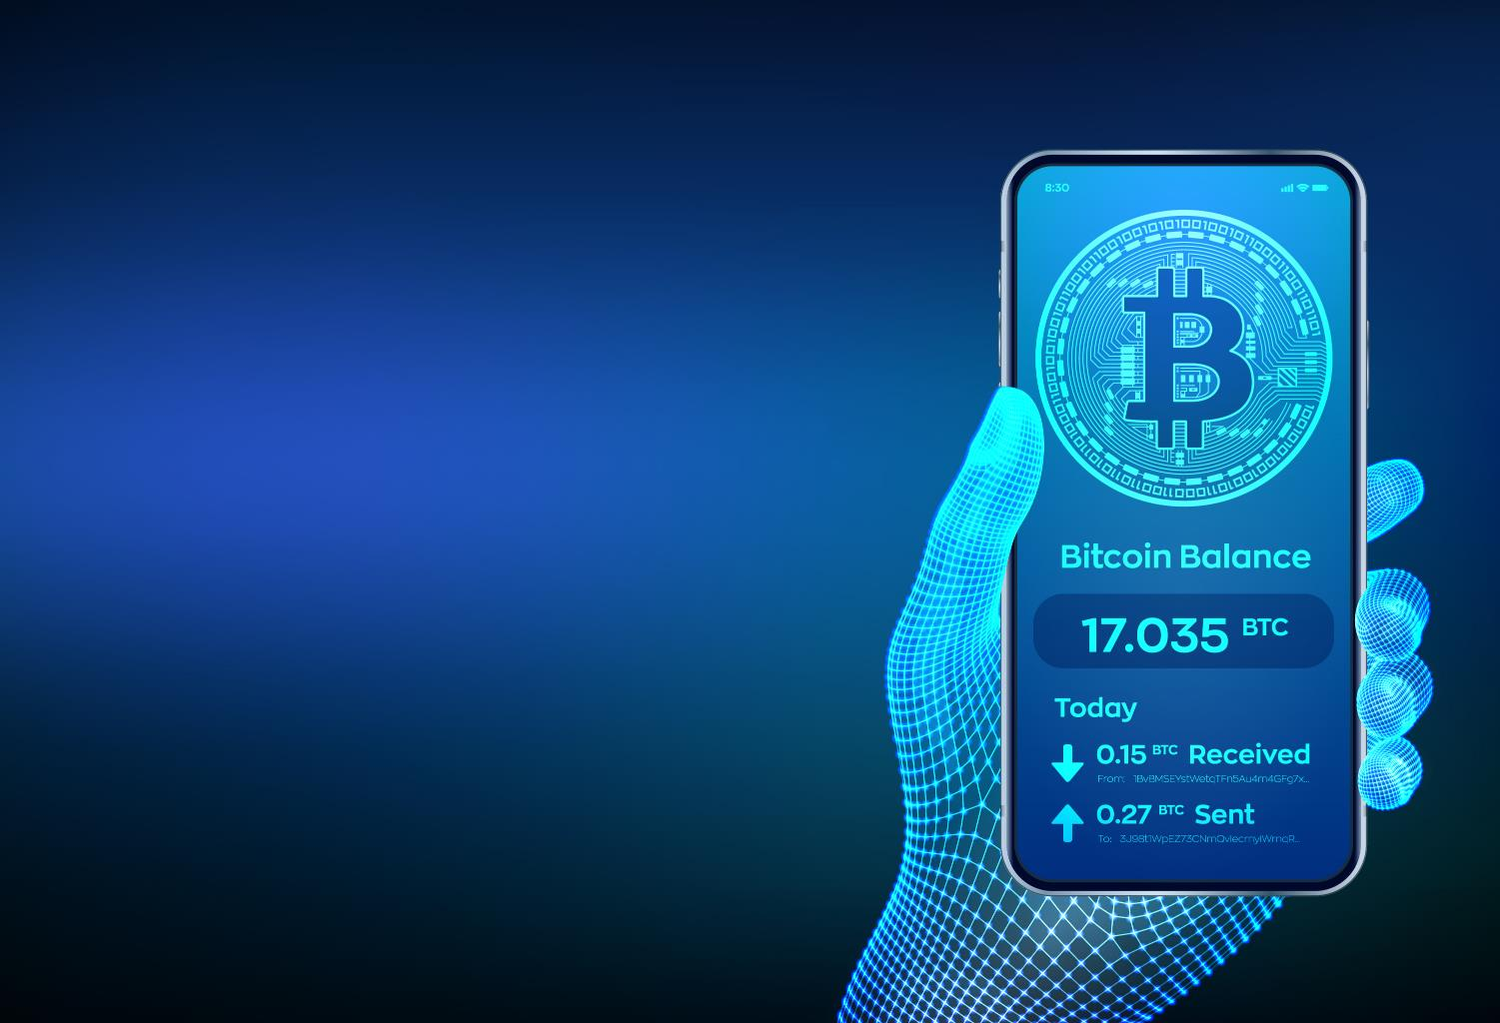
Digital currency uses
International transfers may take days but with digital currency they happen in minutes
Transaction costs are very low and there is no need for a bank account
Some people use their digital currency accounts as a savings account

Slide 14
Digital currency benefits
Digital currencies have many benefits including:
They are hard to counterfeit (although individual accounts may still be hacked)
They may be used anywhere to transfer money anywhere in the world with low fees
The amount of currency available is tightly controlled (new cryptocurrencies cannot be printed by a government)
If the amount of digital currency available is tightly controlled, is hyperinflation possible?

Slide 15
Is hyperinflation prevented?
Is hyperinflation possible with digital currencies?
Yes, hyperinflation (or devaluation) of a digital currency is possible
The supply of digital currencies is heavily controlled in the protocols, so this will not cause hyperinflation
However, if people lose trust in the currency, then no one would want it, meaning that the value falls to zero – this is the equivalent to hyperinflation

Slide 16
Worksheet 7
Complete Task 3 on Worksheet 7

Slide 17

Plenary
Describe how digital currencies (cryptocurrencies) work and the use of blockchain technology
Give two different uses for digital currencies

Slide 18
Plenary
Describe how digital currencies (cryptocurrencies) work and the use of blockchain technology
A public and private key are generated for a cryptocurrency account
The public key is used to add money to the account, whilst the private key is needed to ‘spend’ or transfer money
Every transaction is stored on a digital ledger known as the blockchain. The blockchain stores a time-stamped series of records that cannot be altered
Give two different uses for digital currencies
Sending money abroad; payment of goods; saving

